Slide 1
Topic 11 – Neural Nets, Deep Learning, and AI
Data Science for Business
Prof: Chris Volinsky
NYU Stern: Fall 2024

Slide 2
Deep Learning - Intro
We learned the basics of neural nets in an earlier chapter
Biological inspirations
Black box models for regression and classification
NN explosion since the early 2000s
Moore’s law (computation and storage getting cheaper)
Funded research (Google Brain, MSFT, Facebook FAIR)
It is an incredibly complex and deeply technical field with a lot still to be figured out
Neural nets => Deep Learning => (Gen)AI => AGI(?!??)
ISL – Chap 10

Slide 3
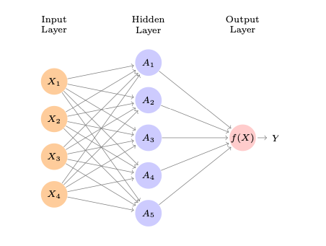
Neural Nets: Single Layer Network
Input Layer: features
Input layer is typically fully connected to a hidden layer using weights that define a linear combination
Nodes in hidden layer apply an activation function
A linear combination of the outputs of the hidden layer get sent to the output layer
Output layer gets transformed (perhaps via threshold)to a prediction

Slide 4
Neural Nets: Single Layer Network
User sets the architecture:
How many nodes? What is the activation function?
The weights are all fit from training data
Uses technique called back-propogation – which iteratively fixes error, given a loss function, using gradient descent
NN are another example of ensemble models

Slide 5
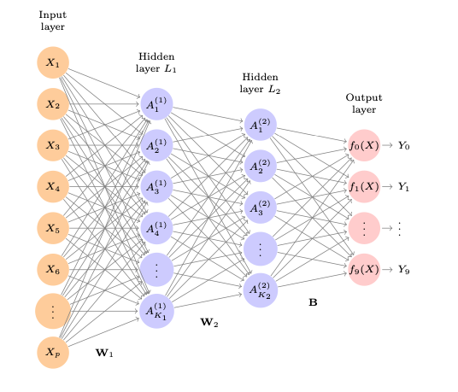
Neural Nets – Deep Learning
Neural nets with multiple hidden layers are referred to as deep.
Often the output layer has multiple classes (like images)
So many parameters!
only feasible within the last 15 years or so
This is a deep learner used to predict handwritten digits
ISL p404
p = 28 x 28 = 784
Hidden layers have 256 and 128 nodes
Total of 235,146 parameters to fit
😱

Slide 6
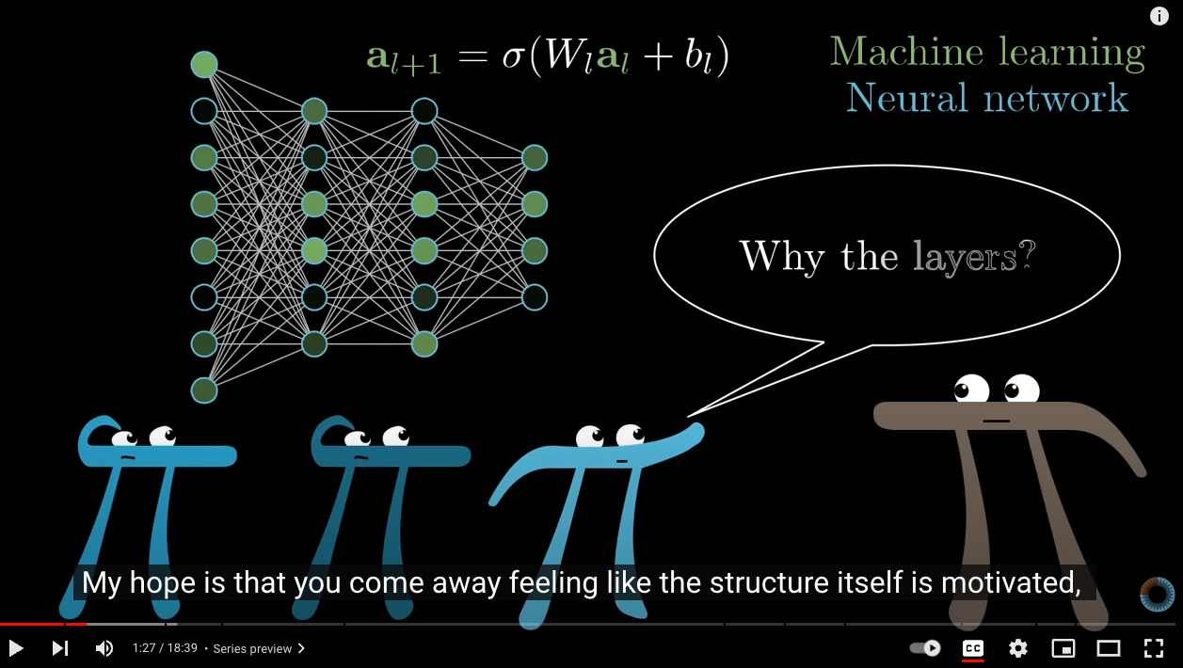
Excellent description of NN
3 Blue 1 Brown YouTube video
But What is a Neural Network??
02:45 => 13:24

Slide 7
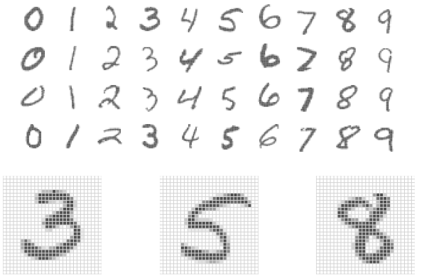
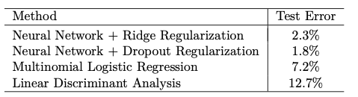
MNIST data
Handwritten digits
28 x 28 matrix of pixels
Each pixel has a value in (0,255)
60k training images
10k test images
Data freely available
Using architecture on previous page:
Notes:
Dropout reg: at different steps set random neurons to zero during different training iterations and averagine…

Slide 8
Extensions of Neural Nets

Slide 9
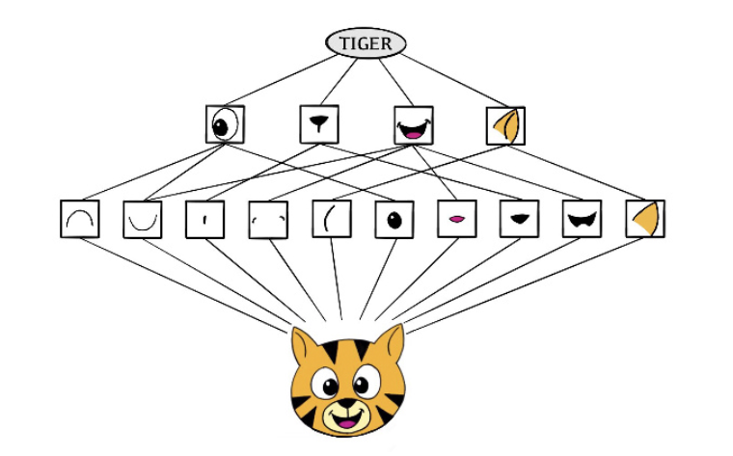
Convolutional Neural Nets (CNN)
Neural Net specifically built for media, images, etc
specifically for grid-based data (like image pixels)
Special layers called convolutional layers focus on detecting patterns such as edges, shapes and textures
Preserves spatial relationships (rather than just looking at each pixel separately
Motivated by how humans detect things
Higher level features: eyes, ears, shapes
Low level features: color, edges, textures

Slide 10
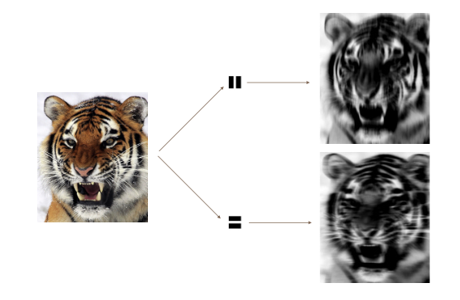
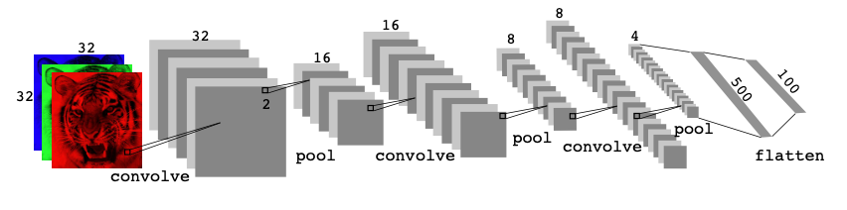
Convolutional Neural Nets (CNN)
Convolving allows you to look for specific patterns:
CNN architectures are very complicated!
Notes:
Like shining a flashlight

Slide 11
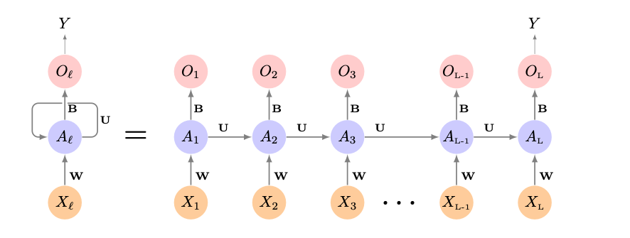
Recurrent Neural Networks (RNN)
Specifically built to handle data where order and context matter
Think words, speech, text
Time Series
RNNs take ordering into account
Keep information from previous inputs and use it to process following inputs
Architecture is sequential and has memory
Keeps a “running mental summary” as it moves along…
But….struggle with long term dependencies
Notes:
LSTMS are able to keep “context” from earlier in the document while parsing local context from most recent context.

Slide 12
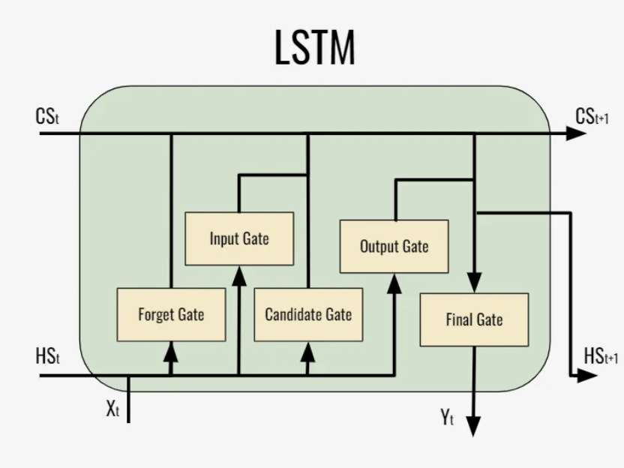
Long Short-Term Memory (LSTM)
Advanced RNNs combining long-term and short-term memory
Can retain important context from the beginning of sequence
Incorporates “gates” which control what gets remembered or forgotten.
Gates are like a notepad, writing down what is important
Improved performance on longer strings, paragraphs
Text, time-series, speech recognition , music composition…
Notes:
Stock prediction, music compoosition

Slide 13
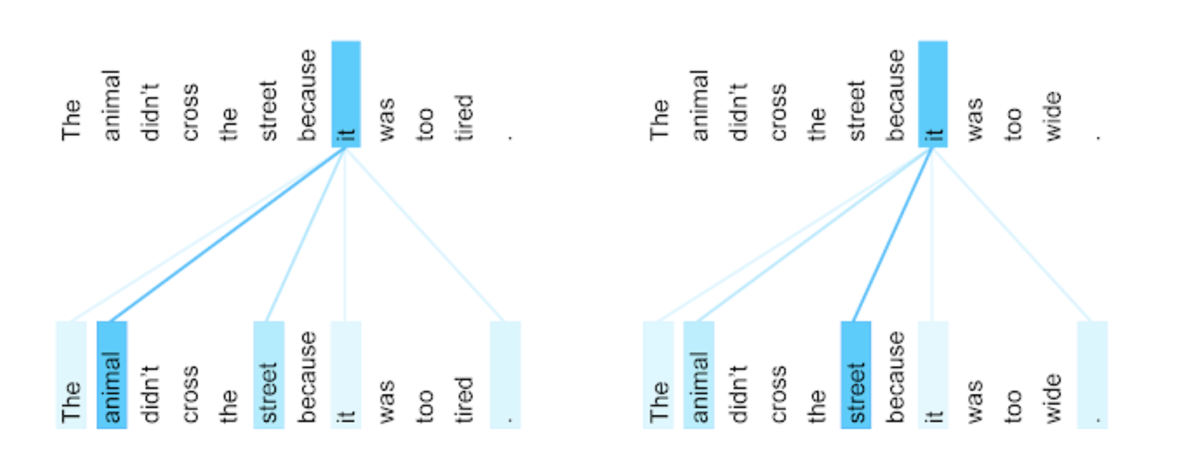
Deep Learning into Generative AI
Another powerful model was developed by researchers at Google in 2017
Attention is All You Need (Vaswani,et al) – introduced Transformer models
Attention allows NNs to
Evaluate a whole page of text at once, not just one word at a time
Considers how each word relates to all other words in the sentence and page
Learns patterns of language (e.g. adjectives come before nouns)
Notes:
These transformers did so well, and seemed to show “intelligence”
The researchers who invented them didn’t even understand
The more training data, the more intelligence they showed.
openAI was the first to release one to the public, trained on hundreds of billions of “tokens”

Slide 14
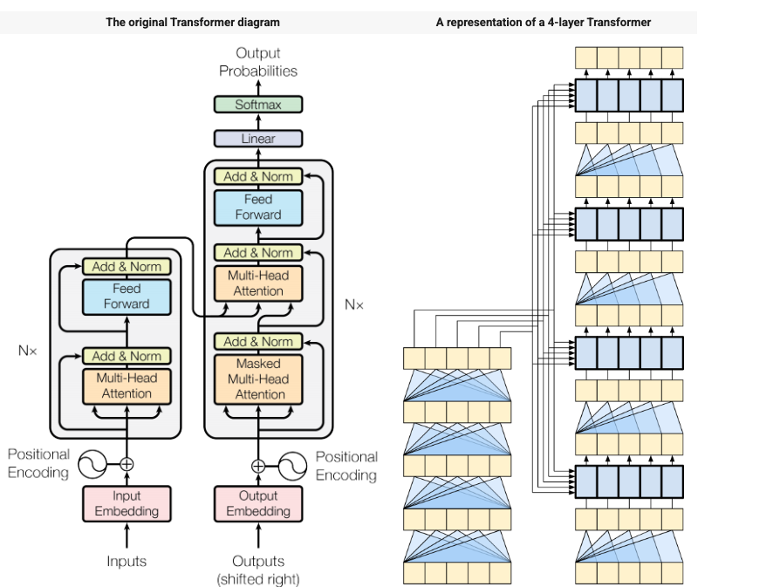

Transformers
Transformers are complicated NN architectures using Attention
Including millions or billions of parameters
GPT was built from Transformers
So…
What is GPT anyway?????
Notes:
What is the training data, the features, the model, the output?
These transformers did so well, and seemed to show “intelligence”
The researchers who invented them didn’t even understand
The more training data, the more intelligence they showed.
openAI was the first to release one to the public, trained on hundreds of billions of “tokens”

Slide 15
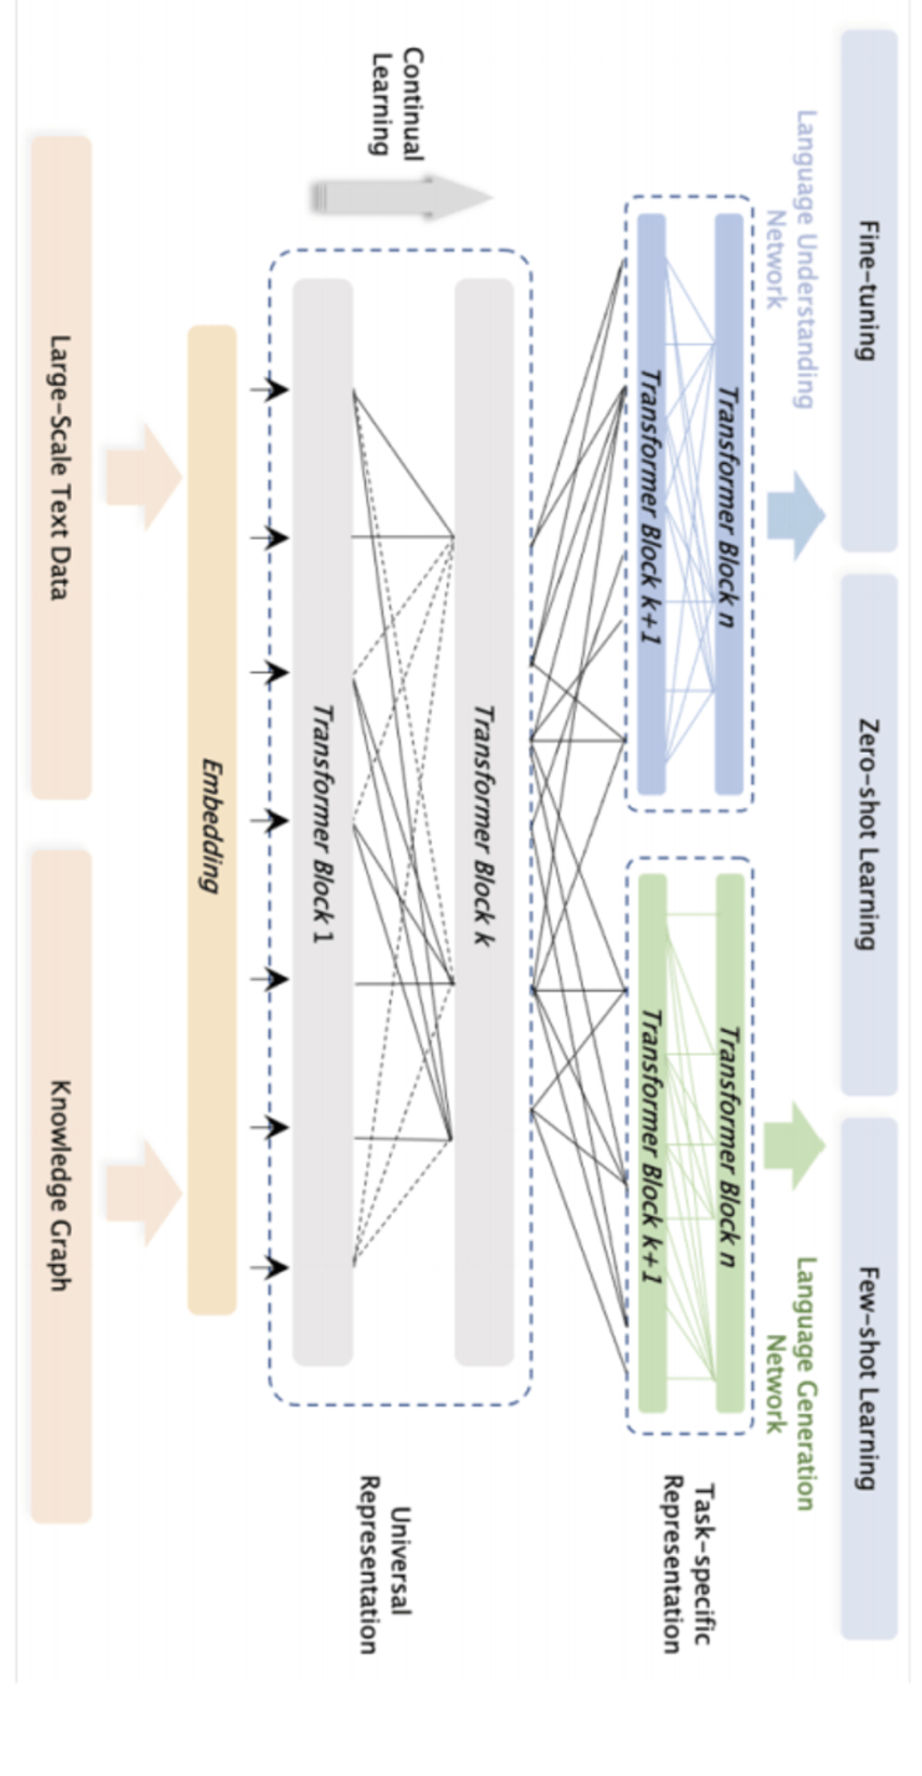
GPT (simplified)
Model Output
(target)
Model Input
(features)
Model
Transformer+
Token | P(token)
jumped | 0.030
Is | 0.020
. | 0.010
went | 0.001
wants | 0.002
plays | 0.001
let | 0.001
, | 0.001
Prompt/Context Window
(Complete this sentence, “the quick brown fox”)
Context Window:
Fixed number of tokens: includes entire conversation plus system prompt
Across entire vocabulary
Training set? : Everything!!!
Notes:
Parameters: model
Input Tokens: how many words, etc can be used as input – Context Window GPT3 = 2k , latest models 128k
Training tokens : how many tokens were used in training
Simplified..not tokens, actually embeddings of the tokens.

Slide 16
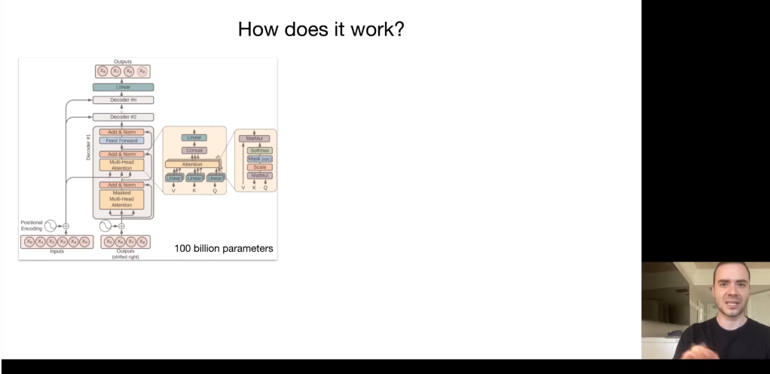
Transformers => Gen AI
As models got larger, so did functionality
Q&A => jokes => dialogue => coding => translation => reasoning
Andrej Karpathy: “Intro to Large Language Models”
We don’t know how these work
Andrej Karpathy
Cofounder of OpenAI
https://yout u.be/zjkBMFhNj_g?t=699
Notes:
13:00-14:00 range

Slide 17
Deep Learning – Useful Tools
Tensorflow
Open source flexible library for building NN
Low level language creates a steep learning curve
Keras
Higher level ”building blocks” interface to Tensorflow (and other tools) makes it good for beginners (see class notebook)
Cant build deeper more complex architectures – but good for beginners
PyTorch
More complicated / flexible
Built for integration into Python, with lots of control
Open source!! Has a large user community
from openai import OpenAI
requires api-key
Netron, FastAI, DL4J – it is a rapidly changing field ..

Slide 18
What do you need to know?
GenAI is not magic, but be careful because we don’t know why it works!
Beware of hallucinations
Useful for many use cases, but not all!
All GPT not created equally
Often simple, old (!), models are cheaper and work just fine
Can use ”fine tuning” to extend GPT knowledge to include specific data
Notes:
Data science “AI bots” are really not that good!

Slide 19

Image Generation
Other models focus on image generation
Learn mappings between languate and visual features
General Adversarial Networks
Two “users” : generator and evaluator
Generator generates a picture and the evaluator gives feedback
Repeat until evaluator cannot tell the difference between real and fake
Another model
Start with an image and slowly add random noise, then teach the system how to reverse the noise process
generate a picture of a data science class in a business school, enjoying their last lecture from their charismatic professor

Slide 20
Deep Learning - summary
Built on neural nets
Can be overkill for simple problems!
Architectures are hard to get right
Beware of overpaying!
Early models of GPT much cheaper and often suitable for task
Could take a lifetime to master these!
Fertile field, constantly changing
ISL book has great descriptions of deep learning in Chapter 10
Including code and examples for
CNN
RNN
Time series predictions

Slide 21
thank you.

